Slide 1


Keras Impl. : Neural Net Introduction
: Binary Classification
: Multiclass Classification
: Image Classification
Tshepo Moagi : Data Scientist BCX

Slide 2
About Me
Engineer Kumba Iron Ore
Crushing Efficiency
Dust suppression system
Optimizing DMS waste plant
Explore Data Science Academy
CT Water Crisis
JSE
CT Traffic
Kaggle - Challenges
Titanic survival
House price prediction
Costa Rica poverty level prediction
EDSA class regression challenge
Zindi-Challenges
Text Classification
Traffic Jam Prediction
Retweet count
Personal Time
Research with CSIR (Some stuff on GANs)
ML Blogger
Hackathons
Business Connections (BCX)
Some stuff on NLP and Internet

Slide 3
Young Background
School of ai
An international school dedicated to studying, teaching, and creating Artificial Intelligence to help solve the world’s most difficult problems.
Director
Siral Raval - He lives to serve all Wizards [the shared moniker of the community]. Inspiring, educating, and guiding them along their journey to help them maximize their positive impact in the world using AI technology.
Deans
Deans are guardians of our mission - “To offer a world-class AI education to anyone on Earth for free. Our doors are open to all those who wish to learn. We are a learning community that spans almost every country dedicated to teaching our students how to make a positive impact in the world using AI technology whether that's through employment or entrepreneurship”

Slide 4
Jargon Guide
Model
Prediction/Inference
Accuracy
Loss
Epoch
Bias [-∞, ∞]
Weights [-1, 1]
Train data
Test data/Validation
Features

Slide 5
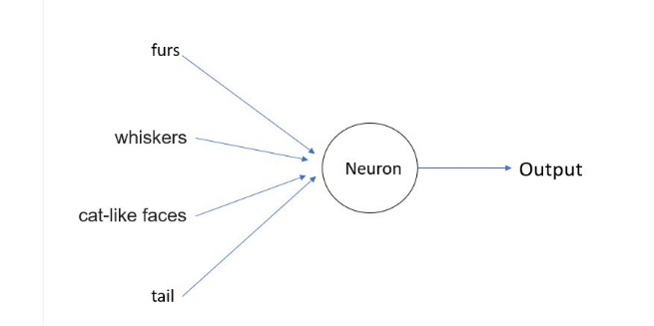
Neuron

Slide 6
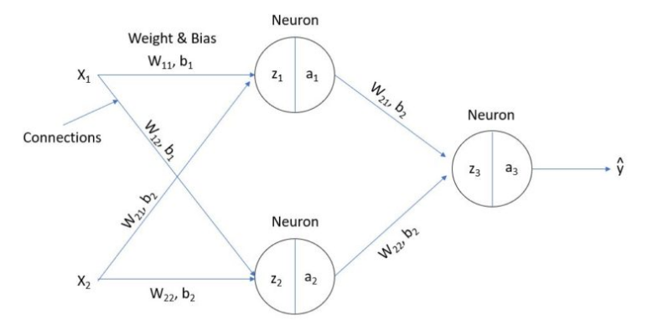
Neural Network
Linear Algebra
Z = Wx + b
Calculus
Sigmoid
Calculus & Stats
Softmax
Probabilities

Slide 7
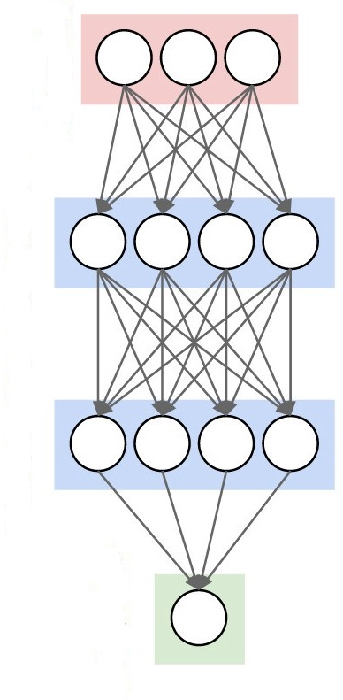
Keras Sequential Model
model.add(Dense(3,input_dim=784))
model.add(Dense(4, activation='sigmoid'))
model.add(Dense(4, activation='sigmoid'))
model.add(Dense(1,activation='softmax'))
https://hackernoon.com/challenges-in-deep-learning-57bbf6e73bb

Slide 8
Loss Functions
Model | Loss
Binary Classification | binary_crossentropy
Multiclass Classification | categorical_crossentropy
Regression | mse
Computer Vision | categorical_crossentropy/ binary_crossentropy

Slide 9
Compiling the Model
# For a binary classification problem model.compile(optimizer='rmsprop', loss='binary_crossentropy', metrics=['accuracy'])
# For a multi-class classification problem model.compile(optimizer='rmsprop', loss='categorical_crossentropy', metrics=['accuracy'])
# For a regression problem
model.compile(optimizer='rmsprop', loss='mse')
# For custom metrics
import keras.backend as K
def mean_pred(y_true, y_pred):
return K.mean(y_pred)
model.compile(optimizer='rmsprop', loss='binary_crossentropy', metrics=['accuracy', mean_pred])

Slide 10
Featurising Images

Slide 11
Predictions on a trained network

Slide 12
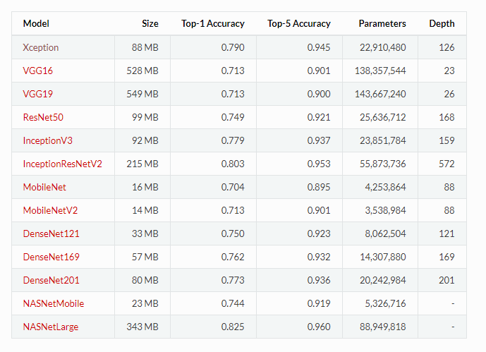
Pre-Trained Models
Parameters - Weights & biases
Depth - Number of layers

Slide 13
Preloaded Datasets
CIFAR10 image classification
CIFAR100 image classification
IMDB Movie reviews sentiment classification
Reuters newswire topics classification
MNIST database of handwritten digits
Fashion-MNIST database of fashion articles
Boston housing price regression dataset

Slide 14
Demo Time

